Slide 1
SPA with React
www.pwc.com
September 2017

Slide 2
About me
Notes:
Jian, 1.5 year on react, cronos
has anyone have basic?

Slide 3
Contents
Why react
Flux architecture
How react works in depth
What redux is
The side-effect and redux-saga
Conclusion
Notes:
Why we need to use react

Slide 4
Why react

Slide 5

Why React
A JAVASCRIPT LIBRARY FOR BUILDING USER INTERFACES
The Appkit | An UI framework build with PwC brand standards
Well supported | Also have the facebook official support Over 1, 000 people contirbuted to react community
Stable and Good performance | Release since 2013 Is one of the fastest framework
Notes:
Most important reason: Need to use appkit in the future
This is the appkit portal
Appkit is build with pwc brand
well supported, contributing
stable,
second best performance

Slide 6
Flux architecture

Slide 7
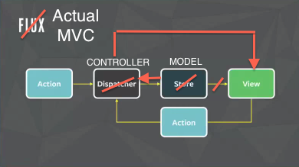
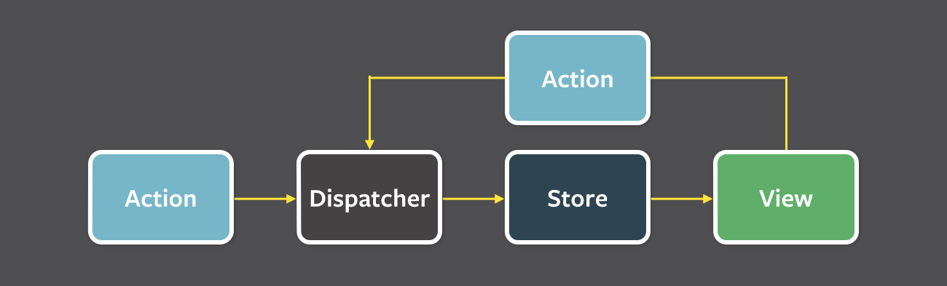
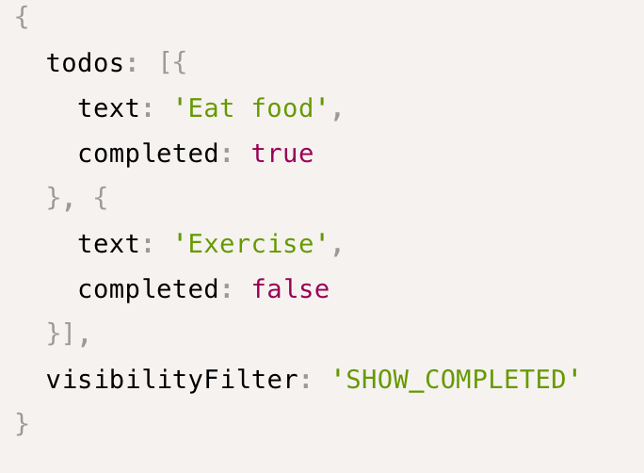
Flux architecture
An Data flow pattern for SPA
The Data flows unidirectional
Notes:
before dive into react
Flux invented by facebook, and applied to many applications that use react
Consist of action, dispatcher, store, view
Action: plain objects, discribe event and it context; comes from
Dispatcher: accept action, pass to store; as controller
Store: object that hold modal of your app
If replace, cover how later
flux is not something new
View is where React servers in this architecture
Only difference is unidirectional,
in mvc, when scale up, controllers can communicate with each other and multiple view
flux aimed to fix this by restrict the dataflow in only one-way
Next, Let divide into react

Slide 8
How react works in depth
Notes:
The state mechanize

Slide 9
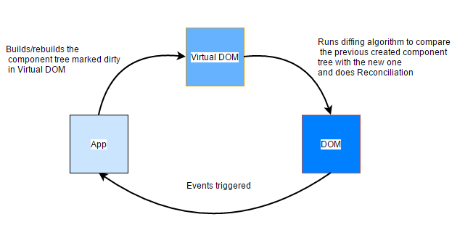
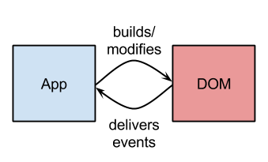
The virtual dom
There is nothing wrong, but it’s low effeciency
Notes:
Browser consist of
Js engine: js runtime env, app lives
render engine: convert html, css to dom. present to screen
bridge between
old school lib.
scale up, Bridge jammed, app stuck, especially on mobile
Solve this issue, virtual dom
Live in js engine, how it help
First time: snapshoot, dom
Update app: new snapshoot, diff algorithm, minimal patch
performance improvement by doing as less thing as possible
Eg: list update: compare, only the changes send to actual dom, others remain same
This is why react is one of best performance framework

Slide 10
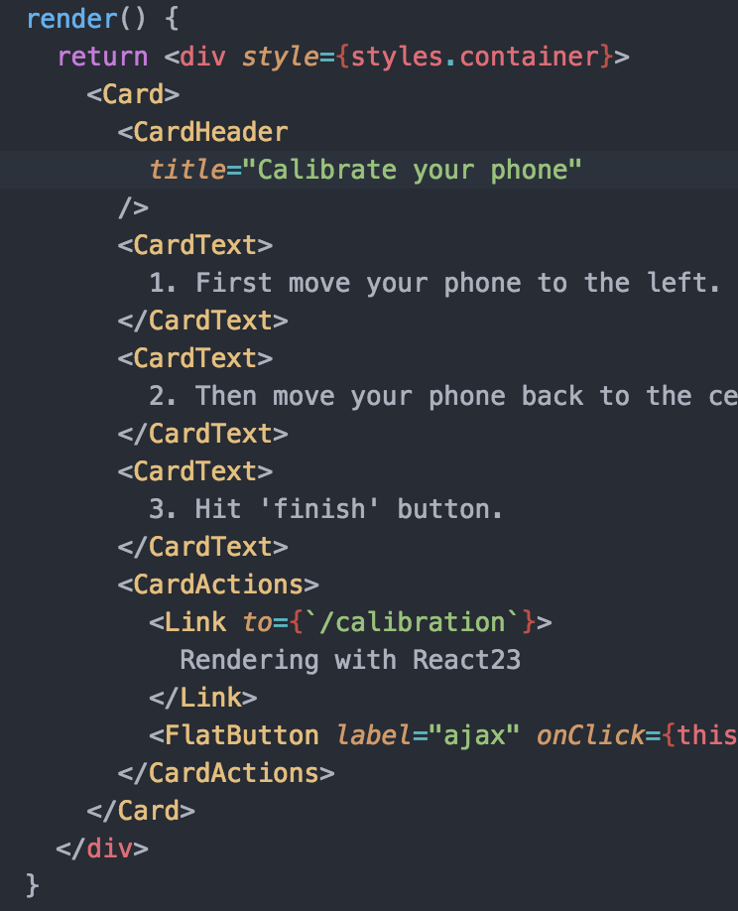
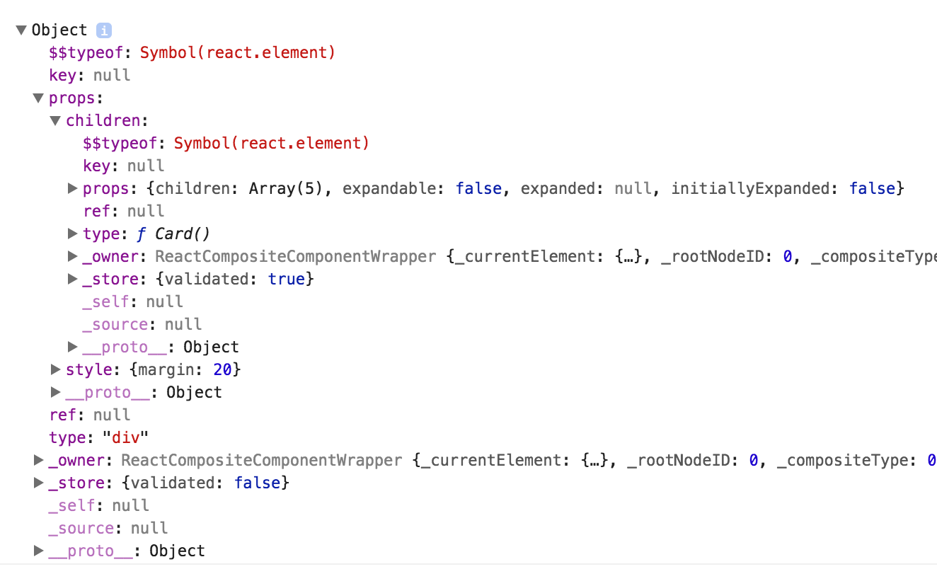
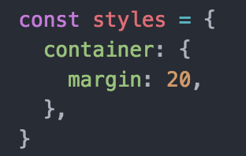
The virtual dom – comes from jsx, turn out as an object
Notes:
JSX: putting html, css in js, cause mess
use JSX to build virtual dom
Show virtual dom, virtual dom is a big JS object,
Details about virtual dom
React knows How to get the changes
Turn out the render performance get much better
Next, How to update dom in react

Slide 11
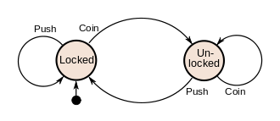
The finite-state machine
Notes:
use event handler change something after event happens, eg: click, ajax, success
difficult when: Scale up, multiple place, shift back
there is a concept finite-state machine
the coin machine, a button on it
lock is state,
insert coin and push are action,
no longer do something,
Define state,
define how ui look under state,
shift to next state, or back
React follows this paradigm, manage easier

Slide 12
State in react
Life cycle
State
Component
Props
ComponentWillUpdate
Initial State
Smart component
Prop types
ComponentWillMount
SetState
Dumb component
Initial Props
Etc.
Higher-order component
Pass Props
Notes:
State: an immutable variable that can be shit by action
go to button.js, show setState, intro background
Component: function define view with JSX
three types component
smart component: logic, go to login.js
dumb component: only for presentation, go to button.js, render faster without logic
Higher order component: a function that take a component and return another component, go to login.js
Props: an object that pass down to child component
this is how we can apply the finite-state machine in our app with react

Slide 13
What Redux is
Notes:
need to share state
setState is not good way to achieve
bring redux into

Slide 14
Redux – Manage state for react.
Dispatch action to reducer
Reducer shift the application to next state
Link the new state back to react component
Notes:
State management tool for app Flux, it make your state predictable
in previous setion, we talked about FLUX
Draw redux’s role
redux does
Dispatch action
reducer to shift state
Link the new state back to react
explain the router,
how to create store,
the reducer, spread operator, first time
dispatch,
the debug tool
connect,
this is unidirectional data-flow in flux

Slide 15
React State Vs Redux state
Redux store:
Things that matter globally
Things that used by multiple components
persistent
React State:
Things just need to live in current component
Won’t impact by other components
Ephemeral
Notes:
save every state into redux? no
Usually the data matter globally, persistent go into redux store
The data use only in one component stay in react state
question?

Slide 16
The side-effect and redux-saga
Notes:
So far just doing everything on client side
in real world, interact
Know side-effect?

Slide 17
Pure function & Side-effect
Pure function:
Reducer are pure function
Side-effect:
Anything not related with the input, output process
Notes:
pure function: input -> output
reducer, accpet state and action, then give back new state
Side effect: not related to the data mutation,
Eg: doing post call
this two concept isolate the logic to two parts:
change state,
doing something about the changes
good for large scale application
doing multiple things when state changes

Slide 18
Redux-saga
Saga:
A redux middleware
Base on es6 generator function
Deal with both complex side effect
benefits:
Work well with promise
Trigger side-effect as observer
Avoid call back hell
Avoid cascading effect when adding new logic
Leave unrelated logic outside the function
Make code easier to test
Generator function:
Definition: Function* ()
Can start, pause, stop
Notes:
saga: redux middle ware to deal with side effect
base on generater
Use saga because belows
Generator function:
The definition
What it does, what it for
Syntax: Asterisk
The yield
Go to example, question any time
want to signIn
apply saga, run saga
Watch action, Handle action
Leave unrelated logic outside function, like the execution order: transform, validate

Slide 19
Conclusion
Notes:
react and redux brings some of the advantage of functional programing, and still follow some object orientation programing style.
it very tough when you first time meet this style
but it helps a lot in a large scale application
the finite-state machine is the core of react-redux
Thing not include:
Flow
Server side rendering,
The optimization
Form input
chart
Unit test
Sign in the form

Slide 20
Server side rendering

Slide 21
Server-side rendering
Config the express
React-dom/server
Send Context into redux store
Notes:
Side effect is something not related to the data mutation
Since the reducer and action should be pure function, we need a way to trigger side effect

Slide 22
The shallow comparison and immutable.js

Slide 23
Immutable.js
What is immutable?
Why the state need to be immutable?
What about data need to be changed?
Notes:
The shallow compare and re-render in react
Immutable is a functional programing term, means once something is created, it’s can’t be changed
The

Slide 24
Charts

Slide 25
Open source library
Victory
Recharts
React-d3
Notes:
Those chart libraries has not as rich features as d3, the appkit also don’t have any chart implement right now

Slide 26
Routing in react
Client side
Structured Resource Transformation process involving on boarding, training and deployment.
Guidewire has experienced practitioners in different product areas viz. Claims, Policy , Billing, Conversion, Reporting and Testing
Mobile App for Claims , a Proof-of-Concept successfully built by integrating with Guidewire Claim Center .
Server side
Salesforce.com has experienced resources with Functional and Technical skills
Certified in Salesforce administration, Sales Cloud, Service Cloud, Salesforce Development

